Slide 1
Accessing SQL from Java and Application Development
Prof. X

Slide 2
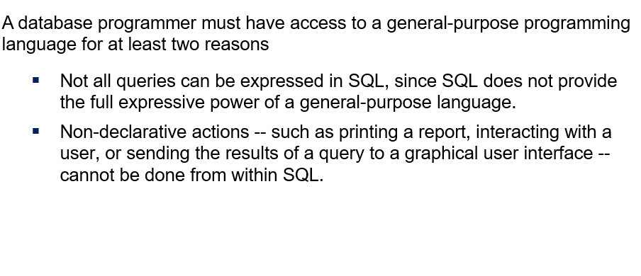
Accessing SQL from a Programming Language

Slide 3
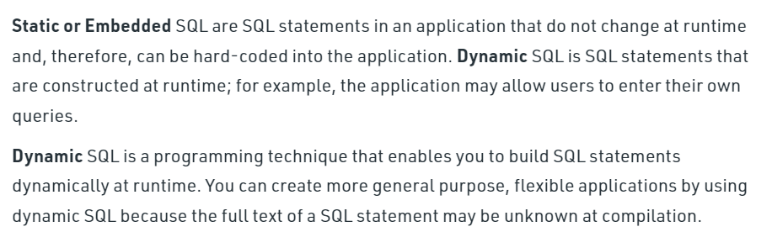
Accessing SQL from a Programming Language (Cont.)
There are two approaches to access SQL from a general-purpose programming language:

Slide 4
JDBC
JDBC is a Java API for communicating with database systems supporting SQL.
JDBC supports a variety of features for querying and updating data, and for retrieving query results.
JDBC also supports metadata retrieval, such as querying about relations present in the database and the names and types of relation attributes.
Model for communicating with the database:
Open a connection
Create a “statement” object
Execute queries using the statement object to send queries and fetch results
Exception mechanism to handle errors

Slide 5
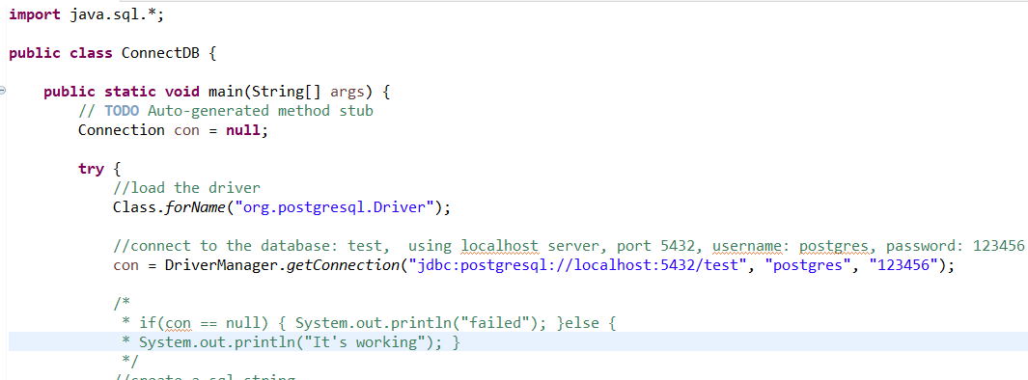
JDBC Code

Slide 6
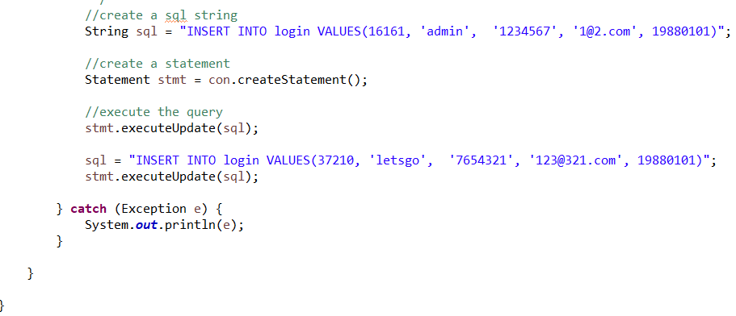
JDBC Code (Cont.)

Slide 7
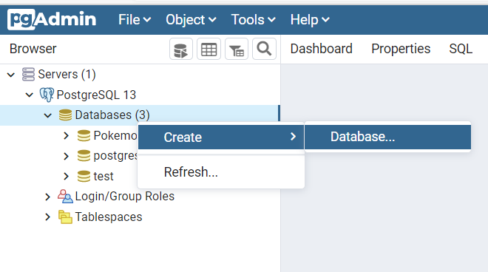
Database-Driven Application
Download and Install PostgreSQL (Optional for the Lab assignment) https://www.enterprisedb.com/downloads/postgres-postgresql-downloads
Server: localhost
Port: 5432
Username: postgres
Keep your password in mind and Do Not forget it
You can easily use pgAdmin to create a new database: application

Slide 8
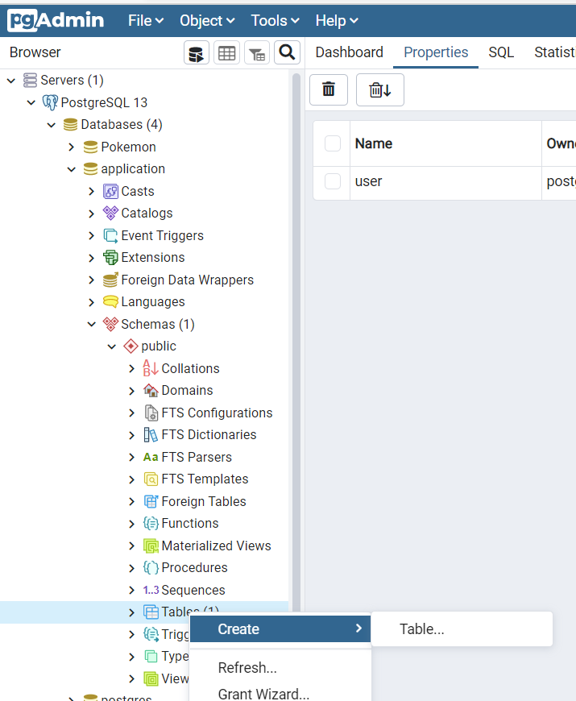
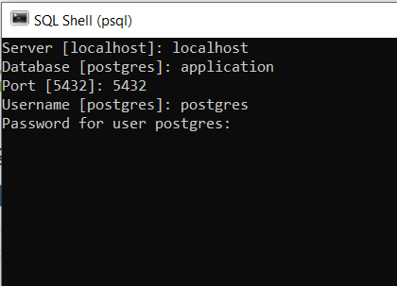
Create database and tables
You can create tables using pgAdmin OR SQL shell

Slide 9
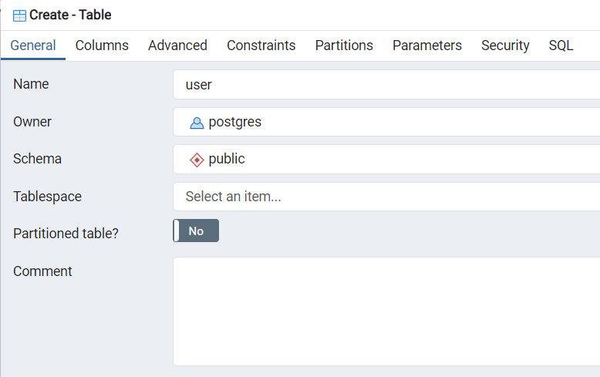
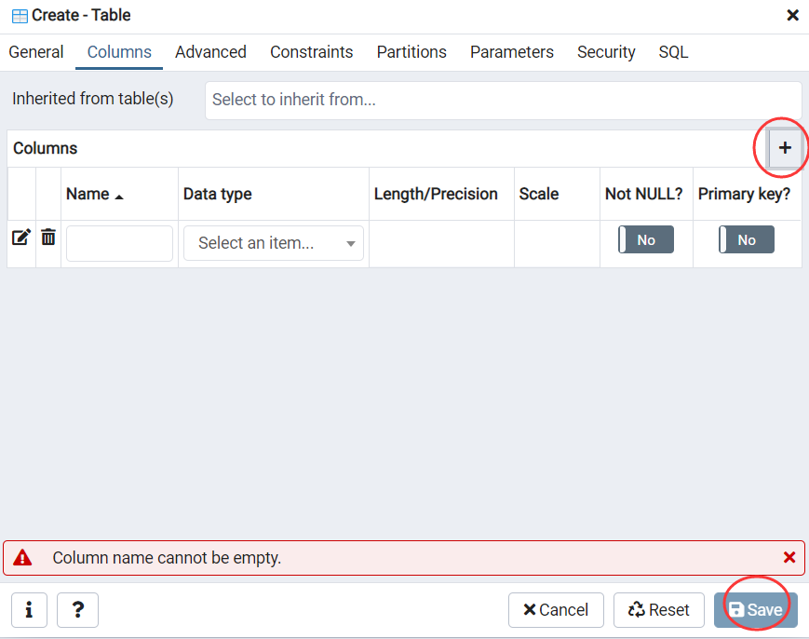
Create tables

Slide 10
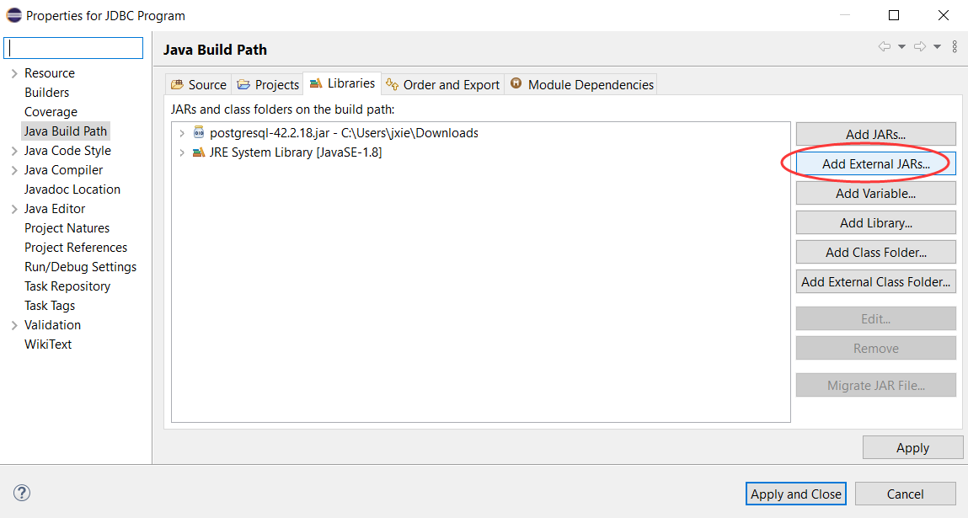
JDBC
Download PostgreSQL java Driver from
https://jdbc.postgresql.org/download/
https://jdbc.postgresql.org/download/postgresql-42.2.19.jar
Keep it, DO NOT discard
Open eclipse and create a new java project
Right click your project → Build Path → Configure Build Path
Add the driver to the library

Slide 11
JDBC
Try the code I provided to connect the database
Make sure you use your own username and password

Slide 12
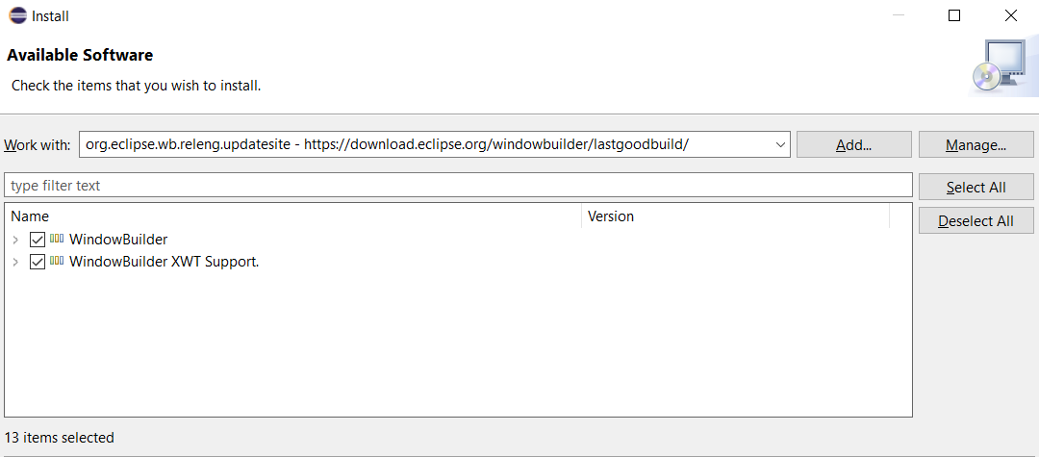
GUI Applications
We need to install Swing to our eclipse
Open Eclipse → Help → Install New Software
Type https://download.eclipse.org/windowbuilder/lastgoodbuild/

Slide 13
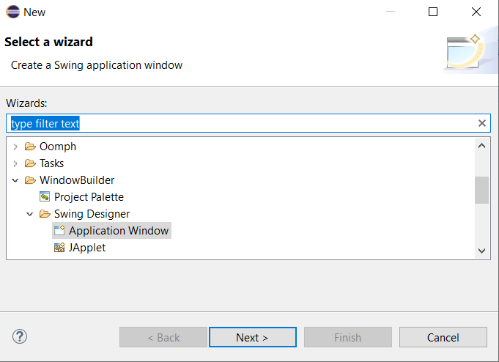
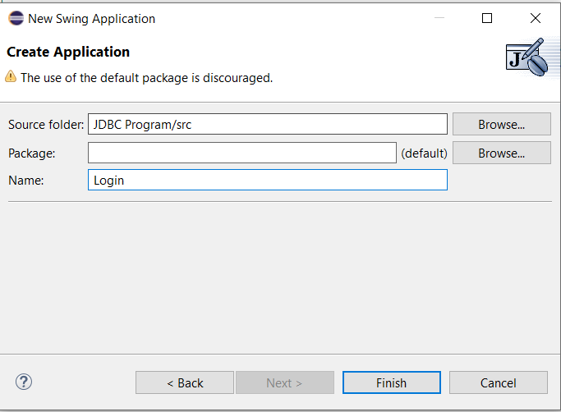
Create a Login Window
Right click the project name → New → Other…
WindowBuilder → Swing Designer → Application Window

Slide 14
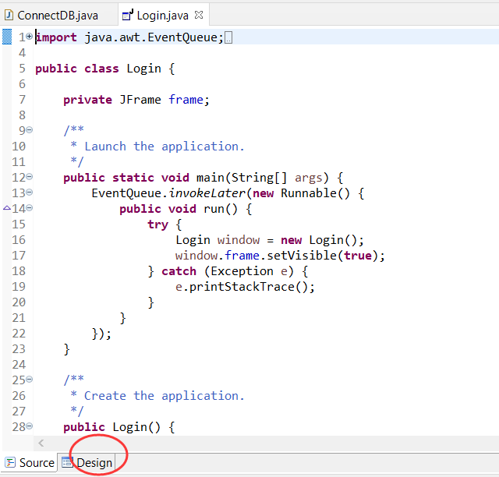
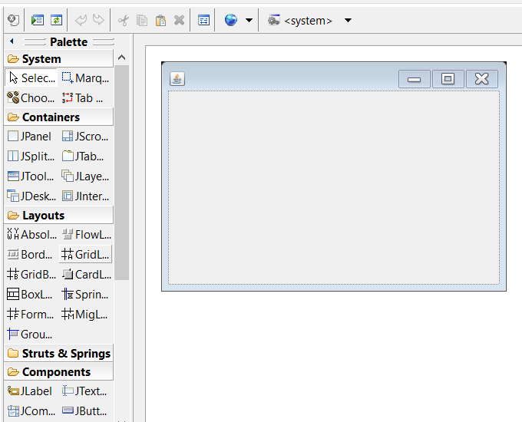
Design Mode

Slide 15
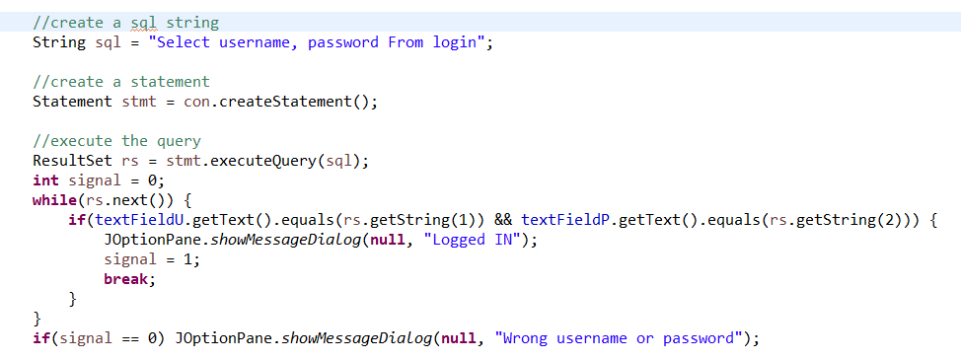
Use Statement and ResultSet

Slide 16
Application Programs and User Interfaces
Most database users do not use a query language like SQL
An application program acts as the intermediary between users and the database
Applications split into
front-end
middle layer
backend
Front-end: user interface
Forms
Graphical user interfaces
Many interfaces are Web-based

Slide 17
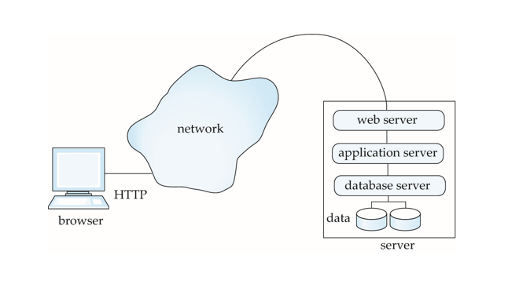
Three-Layer Web Architecture

Slide 18
Web Servers
A Web server can easily serve as a front end to a variety of information services.
The document name in a URL may identify an executable program, that, when run, generates a HTML document.
When an HTTP server receives a request for such a document, it executes the program, and sends back the HTML document that is generated.
The Web client can pass extra arguments with the name of the document.
To install a new service on the Web, one simply needs to create and install an executable that provides that service.
The Web browser provides a graphical user interface to the information service.
Common Gateway Interface (CGI): a standard interface between web and application server

Slide 19
Application Architectures
Application layers
Presentation or user interface
model-view-controller (MVC) architecture
model: business logic
view: presentation of data, depends on display device
controller: receives events, executes actions, and returns a view to the user
business-logic layer
provides high level view of data and actions on data
often using an object data model
hides details of data storage schema
data access layer
interfaces between business logic layer and the underlying database
provides mapping from object model of business layer to relational model of database

Slide 20
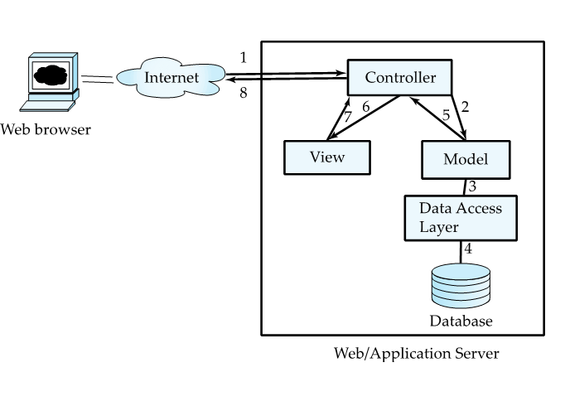
Application Architecture

Slide 21
Business Logic Layer
Provides abstractions of entities
E.g., students, instructors, courses, etc
Enforces business rules for carrying out actions
E.g., student can enroll in a class only if she has completed prerequsites, and has paid her tuition fees
Supports workflows which define how a task involving multiple participants is to be carried out
E.g., how to process application by a student applying to a university
Sequence of steps to carry out task
Error handling
E.g. what to do if recommendation letters not received on time

Slide 22
Object-Relational Mapping
Allows application code to be written on top of object-oriented data model, while storing data in a traditional relational database
Alternative: implement object-oriented or object-relational database to store object model
Has not been commercially successful
Schema designer has to provide a mapping between object data and relational schema
E.g., Java class Student mapped to relation student, with corresponding mapping of attributes
An object can map to multiple tuples in multiple relations
Application opens a session, which connects to the database
Objects can be created and saved to the database using
session.save(object)
Mapping used to create appropriate tuples in the database
Query can be run to retrieve objects satisfying specified predicates

Slide 23
Object-Relational Mapping and Hibernate (Cont.)
The Hibernate object-relational mapping system is widely used
Public domain system, runs on a variety of database systems
Supports a query language that can express complex queries involving joins
Translates queries into SQL queries
Allows relationships to be mapped to sets associated with objects
E.g., courses taken by a student can be a set in Student object
See book for Hibernate code example
The Entity Data Model developed by Microsoft
Provides an entity-relationship model directly to application
Maps data between entity data model and underlying storage, which can be relational
Entity SQL language operates directly on Entity Data Model

